Slide 1
The Art of Problem Solving
O. Univ. Prof. Dr. Alfred S. Posamentier

Slide 2
Ten Problem-Solving Strategies
Working backwards
Finding a pattern
Adopting a different point of view
Solving a simpler, analogous problem
(specification without loss of generality)
Considering extreme cases
Making a drawing (visual representation)
Intelligent guessing and testing (including approximation)
Accounting for all possibilities (exhaustive listing)
Organizing data
Logical reasoning

Slide 3
Working backwards

Slide 4
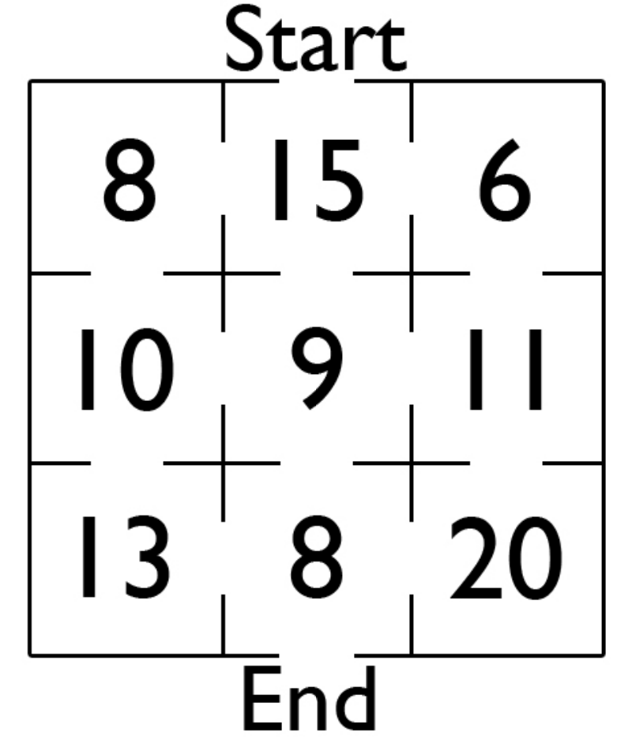
Problem: Find a Path that adds to 50.
You may pass through any open gate, after which that gate closes.
Working backwards:
You must use 8 + 15 = 23.
How can you then get a total of
50 – 23 = 27?
27 = 8 + 10 + 9, that determines the desired path.

Slide 5
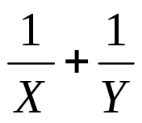
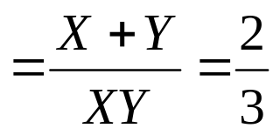


If the sum of two numbers is 2, and the product of the same two numbers is 3, find the sum of the reciprocals of these two numbers
X + Y = 2
XY = 3
To find:
No need to find:

Slide 6
How can 7 liters of water be measured using only an 11 liter can and a 5 liter can?
11 liter can 5 liter can

Slide 7
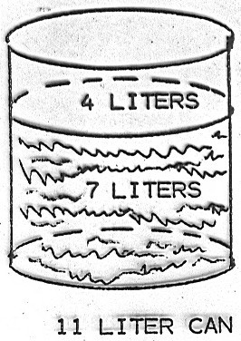
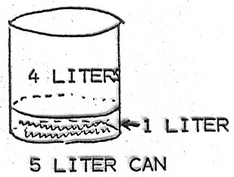
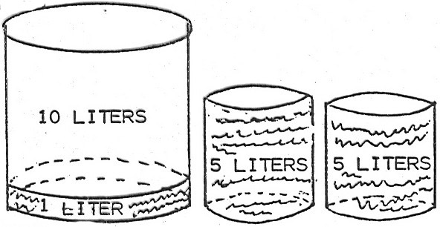
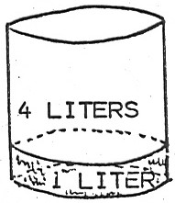
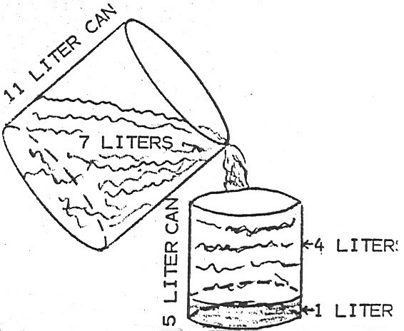
The Desired result: 7 liters of water in 11 liter can.
This leaves 4 liters empty in the can.
How could that have been obtained?
4 liters poured off from a full 11 liter can.
To do this we need 1 liter in the 5 liter can.
How can we get 1 liter in the 5 liter can?
Pour 5 liters twice from the full 11 liter can.
This leaves 1 liter in the 11 liter can,
which is transferred to the empty 5 liter can.
From a full 11 liter can pour off 4 liters by filling
the remainder of the 5 liter can.
This leaves the required 7 liters in the 11 liter can.

Slide 8
Finding a pattern

Slide 9
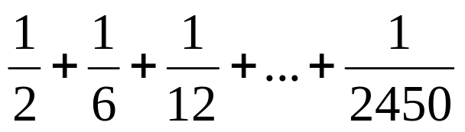
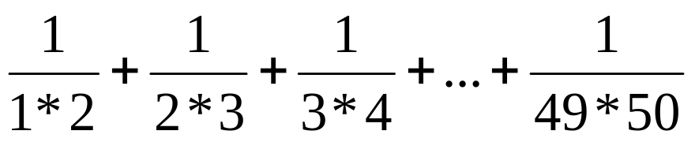
Find the sum of this series:
Students might be shown another way to represent this series:
Solution 1
The traditional way to solve this problem would be to compute the individual values for each of the fractions and then add the results

Slide 10
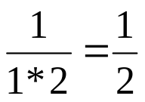
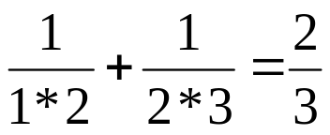
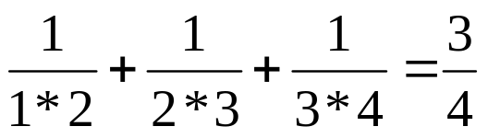
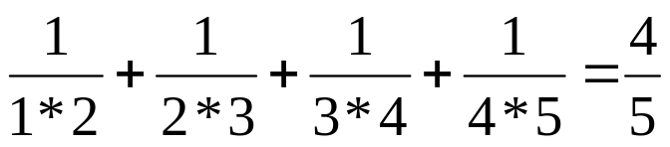
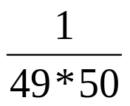

Solution 2
Show the students that there may be a pattern
The pattern suggests that the sum of this series,
with its last term of , will be .

Slide 11
What is the sum of the first 100 even numbers?
Solution 1
Students typically will write out the first 100 even numbers and add them in the order written:
2 + 4 + 6 + 8 + … + 194 + 196 + 198 + 200

Slide 12
They can be clever and add in pairs, recognizing that there is a pattern: (Remember Gauss!)
2 + 200 = 202
4 + 198 = 202
6 + 196 = 202
… and so on.
There are 50 pairs whose sum is 202.
The sum of the first 100 even numbers is
50 * 202 = 10,100.

Slide 13
Solution 2
Looking for a pattern can lead to the following:
For the first 100 even numbers,
the sum would be (100)(101)=10,100.
Number of even numbers to be added | Sum
1 | 2 = 2 = 1*2
2 | 2 + 4 = 6 = 2*3
3 | 2 + 4 + 6 = 12 = 3*4
4 | 2 + 4 + 6 + 8 = 20 = 4*5
n | 2 + 4 + 6 + 8 + ………+ n =n(n+1)

Slide 14
Adopting a different point of view

Slide 15
Hamlet
(Act I, Polonius to Laertes)
“Beware of the entrance to a quarrel, but, being in, bear’t that th’opposed may beware of thee”.

Slide 16
There is a single-elimination basketball tournament with 25 teams competing.
How many games must be played in order to get a winner?
Typical Solution:
Any 12 teams vs. any other 12 teams leaves 12 teams in the tournament.
6 winners vs. 6 other winners leaves 6 teams in tournament.
3 winners vs. 3 other winners leaves 3 teams in tournament.
3 winners + 1 team which drew a bye = 4 teams.
2 teams remaining vs. 2 teams remaining leaves 2 teams in tournament
1 team vs. 1 team to get a champion!

Slide 17
Use a chart:
The total number of games played is:
12+6+3+2+1=24
Teams playing | Games played | Winners
24 | 12 | 12
12 | 6 | 6
6 | 3 | 3
3+ 1 bye=4 | 2 | 2
2 | 1 | 1

Slide 18
Using another point of view:
Consider the losers in the tournament.
There must be 24 losers to get one champion.
Therefore there must be 24 games played.
Still another point of view:
Suppose one of the 25 teams is clearly the best team (and the likely winner).
Have each of the other teams try to defeat this especially good team.
This requires 24 games played.

Slide 19
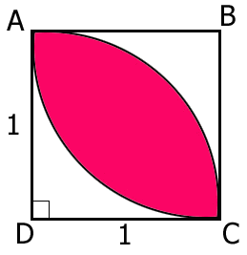
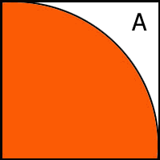
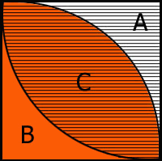
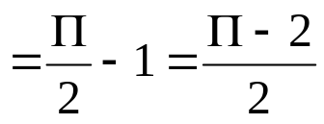
Find the area of the “Football shaped” figure
ABCD is A unit square
Arcs are quarter arcs
Regions A and B were counted once
while region C was counted twice.
Therefore, area of “football” = area of 2 quarter circles – Area of square

Slide 20

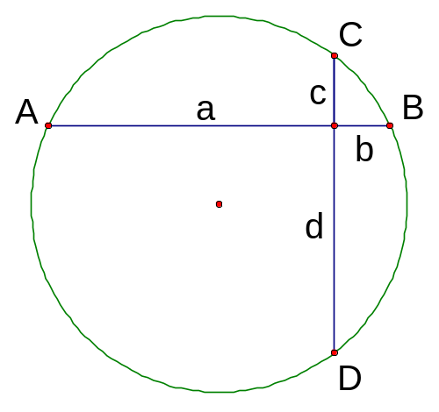
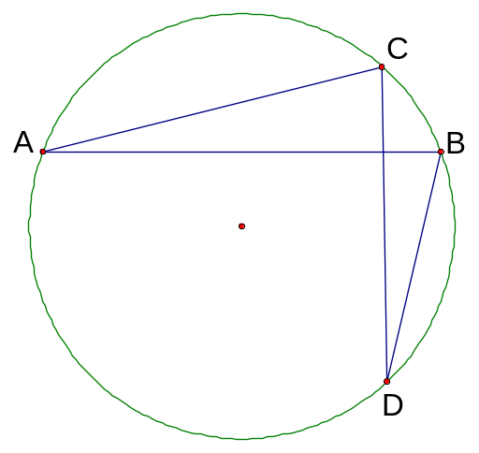
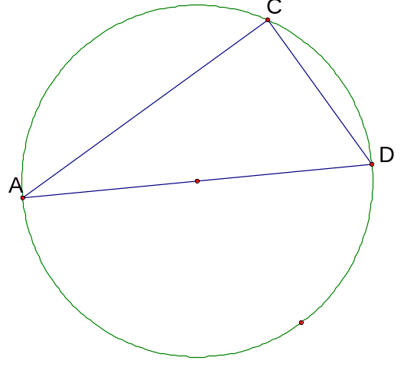


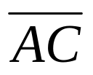


Problem
In the adjoining circle , find the length of the diameter in terms of a, b, c and d.
Solution
Use the strategy of considering another point of view:
We draw the two segments whose lengths are and ,
respectfully.
The two chords and cut off two arcs whose sum is 180º
Therefore, placed together they determine a semicircle,
and a diameter

Slide 21
A
C
E
5
B
o
D
C is any point on
the circle.
What is the radius
of the circle?

Slide 22
Solving a simpler, analogous problem

Slide 23
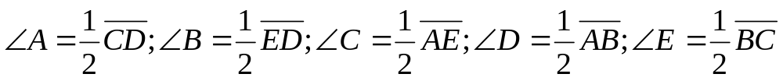
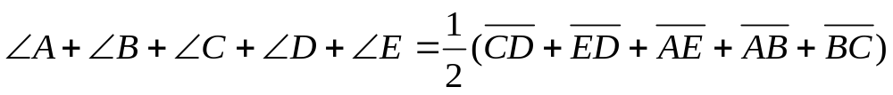
Find the sum of the angles
Consider measures:
B
A
C
D
E

Slide 24
Considering extreme cases

Slide 25
The tangent AB of the smaller of the two concentric circles is a chord of the larger circle. Find the area of the shaded region, if AB=8.
Area of shade= ΠR² - Πr² = Π(R²- r²)
“Products of chords”: (R - r)(R + r)=4 * 4=16
R²- r²=16
Therefore , area of shade = 16Π
Or: Assume the smaller circle is reduced to a point.
Then AB becomes to diameter of the larger circle.
The area of shaded region (larger circle) = Π R²=16 Π
T
C
A
B
R-r
A
4
T
4
B
O
r
O
R+r
R
D

Slide 26
Problem: Two concentric circles are 10 units apart.
What is the difference (a constant) between the circumferences of the circles?
10

Slide 27


The traditional straight-forward method:
Let d be the diameter of the smaller circle,
then d + 20 is the diameter of the larger circle.
The difference of the circumferences is
Applying the strategy of using extremes
Suppose that the smaller of the two circles gets smaller and
smaller until it reaches and “extreme” -- and becomes a point.
In this case it becomes the center of the larger circle.
The distance between the circles now becomes the radius of the larger circle,
while the difference between the circles at the start, is now the circumference of the larger circle, which is 20 .

Slide 28
Problem:
We have two one-Liter bottles.
One contains a half-liter of grape juice and the other, a Half-liter of apple juice.
We take a tablespoonful of grape juice and pour it into the apple juice.
Then we take a tablespoon of this new mixture (apple juice and grape juice) and pour it into the bottle of grape juice.
Is there more grape juice in the apple juice bottle, or more apple juice in the grape juice bottle?

Slide 29
Solution:
We can figure this out in any of the usual ways-often referred to as “mixture problems” – or we can be clever and use the strategy of using extremes.
To do this, we will consider the tablespoonful quantity to be a bit larger. We will use an extremely large quantity.
Let this quantity be the entire one-liter of the grape juice and pour it into the apple juice bottle.
This mixture is now 50% apple juice and 50% grape juice.
Then pour one-liter of this mixture back into the grape juice bottle
The mixture is now the same bottles.
Therefore, there is as much apple juice in the grape juice bottle, as there is grape juice in the apple juice bottle!

Slide 30
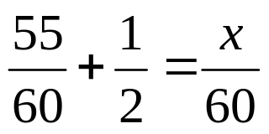
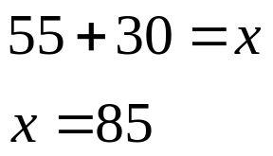
Problem: A car is driving along a highway at a constant speed of 55 miles per hour. The driver notices a second car, exactly ½ mile behind him. The second car passes the first, exactly 1 minute later. How fast was the second car traveling, assuming its speed is constant?
Solution
The traditional solution to set up a series of “Rate x Time=Distance-boxes,” which many text books guide students to using for this sort of problem. This would be done as follows:
The second car was traveling at a rate of 85 miles per hour.
Rate x Time = Distance
55 | 1/60 | 55/60
x | 1/60 | X/60

Slide 31
An alternate approach using the strategy of considering extremes.
Assume that the first car is going extremely slowly, that is, at 0 miles per hour.
Under these conditions, the second car travels ½ mile in one minute to catch the first car.
Thus, the second car would have to travel 30 miles per hour.
As the first car is traveling at 55 m.p.h, then the second car must be traveling at (55 + 30) 85 miles per hour (within the legal limit, of course!).

Slide 32

The Monty Hall Problem
(“Let’s Make a Deal”)
There are two goats and one car behind three closed doors.
You must try to select the car.
You select Door #3
1
2
3

Slide 33

Monty Hall opens one of the doors that you did not select and exposes a goat.
He asks : “Do you still want your first choice door, or do you want to switch to the other closed door”?
1
2
3
Your selection

Slide 34
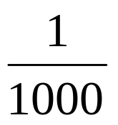
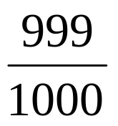
To help make a decision, Consider an extreme case:
Suppose there were 1000 doors
1
2
3
4
997
998
999
1000
You choose door # 1000.
How likely is it that you chose the right door?
Very unlikely:
How likely is it that the car is behind one of the other
doors: 1-999?
“Very likely”:

Slide 35
1
2
3
4
997
998
999
1000
Monty hall now opens all the doors except one (2-999), and
shows that each one had a goat.
A “very likely” door is left: Door #1
Which is a better choice?
Door #1000 (“Very unlikely” door)
Door #1 (“Very likely” door.)

Slide 36
1
2
3
4
997
998
999
1000
These are all “very likely” doors!
So it is better to switch doors from the initial selection.

Slide 37
Making a drawing

Slide 38
Problem:
If a clock strikes 5 bongs at 5 o’ clock in 5 seconds,
how long will it take to strike 10 bongs at 10 o’ clock?
(Assume that the bong itself takes no time.)
The answer is not 10 seconds!

Slide 39

With the dots representing the bongs, this is what happens at 5 o’ clock:
11
2
31
41
5
It takes 5 seconds and there are 4 intervals,
therefore each interval must take 5/4 seconds.
At 10 o’ clock the 10 bongs give us 9 intervals.
11
2
31
41
51
61
71
81
91
10
So with each interval taking 5/4 seconds,
the clock striking at 10 o’ clock will take 9 x = 11 ¼ seconds.

Slide 40
Problem:
A local pet shop owner just bought her holiday supply of baby chickens and baby rabbits.
She doesn’t really remember how many she bought but she has a system.
She knows she bought a total of 22 animals, a number exactly equal to her age.
She also recalls that the animals had a total of 56 legs, her mother’s age.
How many chickens and how many rabbits did she buy?

Slide 41
Solution:
The standard approach is to set up a system of two equations in two variables as follows:
Let r represent the number of rabbits she bought.
Let c represent the number of chickens she bought.
Then, r + c = 22
4r + 2c = 56(rabbits have four legs each; chickens have two legs each).
Solving these equations simultaneously yields
4r + 4c = 88
4r + 2c = 56
2c = 32
c = 16
r = 6
The pet shop owner bought 16 chickens and 6 rabbits.

Slide 42
Reduce the number of animals to 11, and the number of legs to
28, (remember to multiply these results by 2.
Now draw 11 circles to represent the 11 animals.
Whether the animals are chickens or rabbits, they must have at least 2
Legs each. Place 2 legs on each circle:
This leaves us with 6 additional legs, which we place on the “rabbits” in pairs,
to give them a total of 4 legs each:

Slide 43
Intelligent guessing and testing

Slide 44
Find four consecutive integers whose product is 120.
Let x equal the first of four consecutive numbers
Let (x+1) equal the second of the four consecutive numbers
Let (x+2) equal the third of the four consecutive numbers
Let (x+3) equal the fourth of the four consecutive numbers
x(x+1)(x+2)(x+3)=120
This leads to:
x⁴ + 6x³ +11x² + 6x – 120 = 0
Much easier to try:
2 3 4 5 = 120

Slide 45
Accounting for All Possibilities

Slide 46

Problem: If four coins are tossed, what is the probability that at least two heads will be showing?
We can use methods of probability calculation to obtain this answer quite quickly, if we recognize the appropriate “formula” to use.
The list of all the possibilities
(the sample space)
HHHH HHHT HHTH HTHH
THHH HHTT HTHT THHT
HTTH THTH TTHH HTTT
THTT TTHT TTTH TTTT
There are 11 of with at least 2 H’s.
The required probability is .

Slide 47
Organizing data

Slide 48
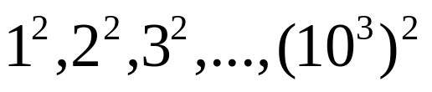
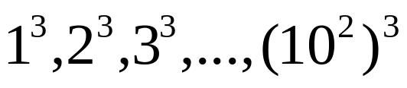
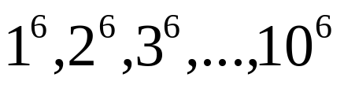
Problem:
How many numbers are there between 0 and 1,000,001
that are either squares or cubes?
Solution:
Use a systematic counting approach.
The number of squares is
1000 numbers
The number of cubes is:
100 numbers
The number of numbers which are both squares and cubes is:
10 numbers
The total of numbers which are either squares or cubes is:
1000 + 100 – 10 = 1090 numbers.

Slide 49
Problem: Using the digits 1,2,3,4,5 form three prime numbers with the greatest sum and where exactly one is a single digit prime.
Solution: After random trials and errors, use organizing data and logical reasoning.
Set up the following skeleton of the three numbers:
 | Ten’s | Unit’s
First prime | 5
Second prime | 4
Third prime |  | 2
To maximize the sum we want to have the two greatest digits 5 and 4 in the two ten’s places. Since one prime must be single digit, it must be 2, since it is the only even prime.

Slide 50
All that remains now is to place the 1 and 3 into positions, which will yield prime numbers.
 | Ten’s | Unit’s
First prime | 5 | 3
Second prime | 4 | 1
Third prime |  | 2
The sum 53 + 41 + 2 = the greatest sum.

Slide 51
Logical reasoning

Slide 52
Problem:
In Dr. Euler’s class there are 25 students seated in 5 rows with
5 seats in each row. One day he asks the students to change
seats as follows:
Each student must move one seat forward or backward or one
seat to the left or to the right – diagonal moves are not allowed.
Is it possible that all 25 students follow these instructions?

Slide 53
Solution:
Traditional approach is to try various moves.
This usually leads to frustration.
Solving a simpler, analogous problem,
(and making a drawing)
Draw a diagram and number the seats:
21 | 22 | 23 | 24 | 25
20 | 19 | 18 | 17 | 16
11 | 12 | 13 | 14 | 15
10 | 9 | 8 | 7 | 6
1 | 2 | 3 | 4 | 5

Slide 54
Some seats have even numbers and some have odd numbers.
Where do the students in the seats with even numbers go?
If they move as Dr. Euler instructed, they can chose to move to
four different chairs, all odd number chairs.
Where do the students in the seats with odd numbers go?
They can also choose to move to four different chairs, all even numbers.
21 | 22 | 23 | 24 | 25
20 | 19 | 18 | 17 | 16
11 | 12 | 13 | 14 | 15
10 | 9 | 8 | 7 | 6
1 | 2 | 3 | 4 | 5

Slide 55
But since the numbers from 1 to 25 include 13 odd numbers
and only 12 even numbers, there will be one student left over,
who cannot move from an odd numbered chair to an even one.
21 | 22 | 23 | 24 | 25
20 | 19 | 18 | 17 | 16
11 | 12 | 13 | 14 | 15
10 | 9 | 8 | 7 | 6
1 | 2 | 3 | 4 | 5
Therefore, it is not possible for Dr. Euler’s students to switch
seats as they were told to do.

Slide 56
Problem:
The population of Canada is about 25 million. Is it possible that
at least two people in Canada have the same number of hairs
on their head?
Solution:
Use logical reasoning:
Do we really have to know each citizen’s number of head-hairs?
How many hairs can there possibly be on a human’s head?
We only have approximations, there are certainly less than
25 million hairs on an average head.
Since there are more people than the possible number of hairs,
it follows that at least two people have the same number of
Hairs. (pigeon-hole principle)

Slide 57
Problem:
What is the smallest prime number that divides the sum
5¹¹ and 7¹³ ?
Solution:
Use logical reasoning:
Both 5¹¹ and 7¹³ are odd numbers
(since the product of the odd numbers is odd).
Therefore the sum of these two odd numbers :
5¹¹ + 7¹³ is even.
The smallest prime number that divides the sum
5¹¹ + 7¹³ is 2 (since it is the only even prime).

Slide 58
The goal :
is to have an arsenal of Elegant and efficient
problem-solving strategies
at one’s disposal.
Problem solving = textbook exercises
Problem solving Strategies
can be applied to Mathematics
and
everyday-life situations.
Be ready to use problem-solving strategies
in your regular lessons!
EMPHASIZE THE PROCESS!

Slide 59
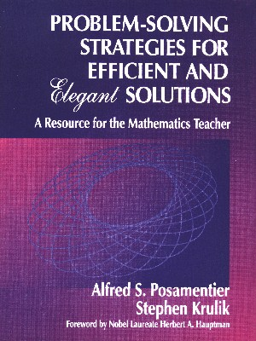
Problem-Solving Strategies For
Efficient and Elegant Solutions:
A Resource for the Mathematics Teacher
* * *
Alfred S. Posamentier, and
Stephen Krulik
Foreword by Nobel Laureate
Herbert A. Hauptman
1998, 272 pages •
D0715-0-8039-6698-9 (Paper) $32.95
D0715-0-8039-6697-0 (Library Edition) $69.95
Order by Phone at (805) 499-9774
or at (800) 4-1-SCHOOL
[(800)-417-2466]

